Slide 1
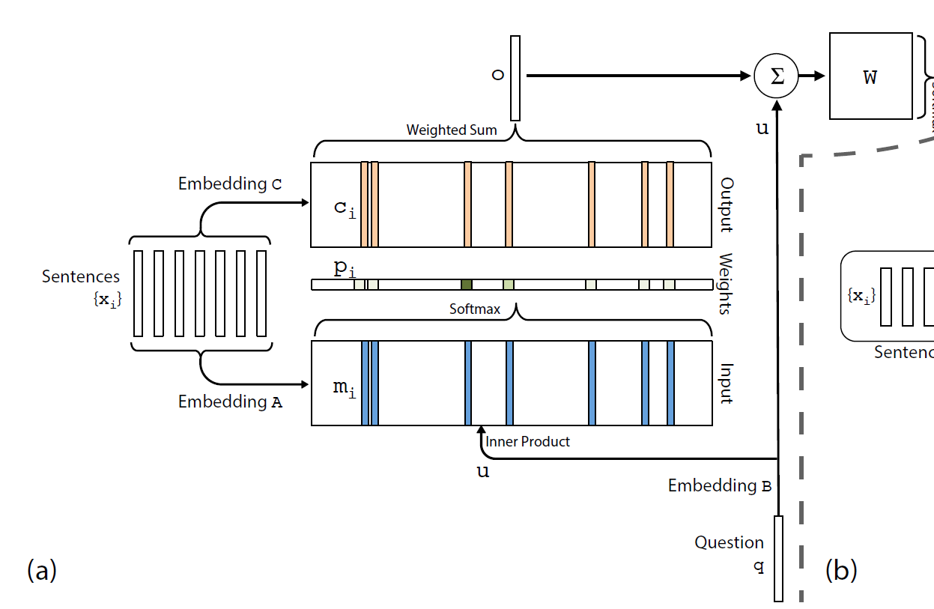
What is Memory Network?
MemNNs have four component networks :
I: input feature map
G: update memories given new input.
O: produce new output
R: convert output O into
response

Slide 2




Why it works?
Answer
kitchen
Memory Module
Weighted Sum
Controller
Dot product + softmax
1: Sam moved
to garden
2: Sam went
to kitchen
3: Sam drops
apple there
Where is Sam?
Question
Input story
Notes:
Here we are applying our model to QA task
But note that it can be used in other tasks such as lang model

Slide 3
Why it works?
Incorporates reasoning with attention over memory (RAM).

Slide 4
MemNN V.S. MemN2N
explicit supervision V.S. End–to–End
hard attention V.S. soft attention

Slide 5
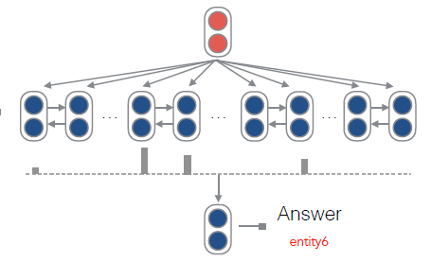
Memory & Attention

Slide 6
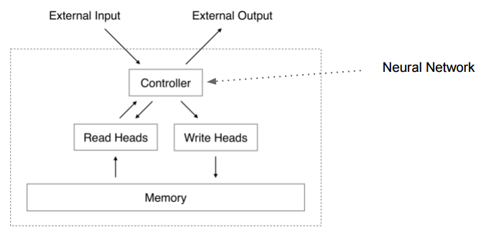
Memory & Attention
Neural Turing Machines

Slide 7
Classic NLP tasks
Machine translation:
“Sequence to Sequence Learning with Neural Networks” I. Sutskever, O. Vinyals, Q. Le.
“Neural Machine Translation by Jointly Learning to Align and Translate” D. Bahdanau, K. Cho, Y. Bengio.
Entailment:
“Reasoning about Entailment with Neural Attention” T. Rocktäschel, E. Grefenstette, K. Hermann, T. Kočiský, P. Blunsom.
Summarization:
“A Neural Attention Model for Abstractive Sentence Summarization” A. M. Rush, S. Chopra, J. Weston.

Slide 8
RAM Issues
How to decide what to write and what not to write in the memory?
How to represent knowledge to be stored in memories?
Types of memory (arrays, stacks, or stored within weights of model), when they should be used, and how can they be learnt?
How to build hierarchical memories, e.g. multiscale attention?
How to build hierarchical reasoning, e.g. composition of functions?
How to incorporate forgetting/compression of information?
How to evaluate reasoning models? Are artificial tasks a good way? Where do they break down and real tasks are needed?

Slide 9
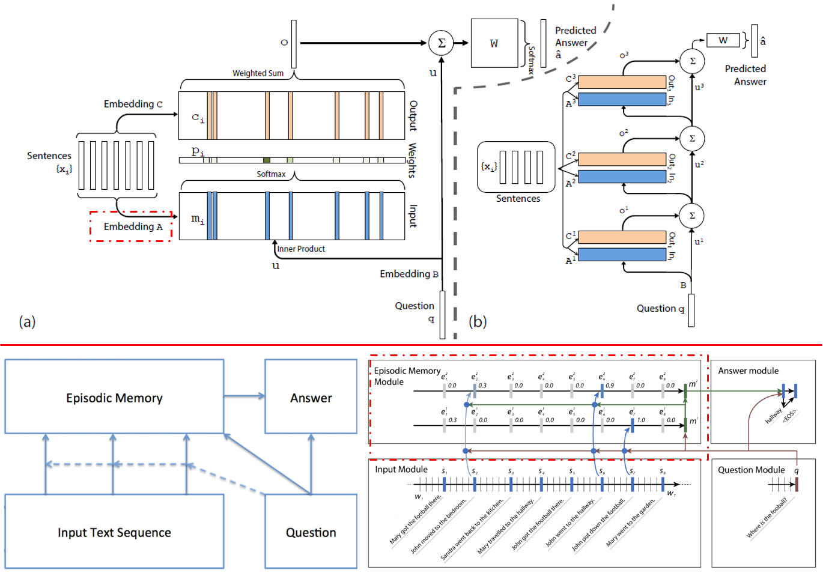
ICML16-Socher-Ask Me Anything Dynamic Memory Networks for Natural Language Processing

Slide 10
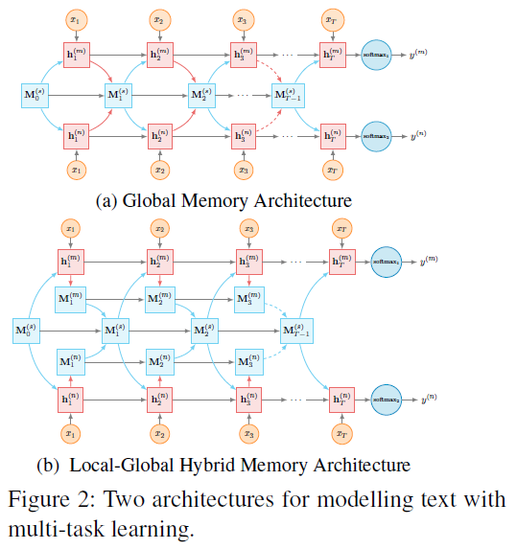
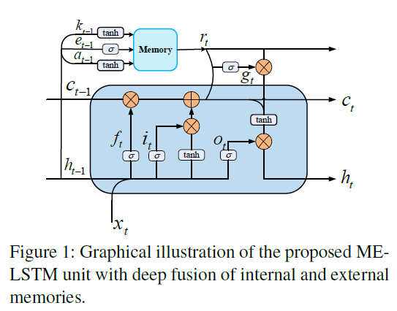
EMNLP16-FDU-Deep Multi-Task Learning with Shared Memory

Slide 11
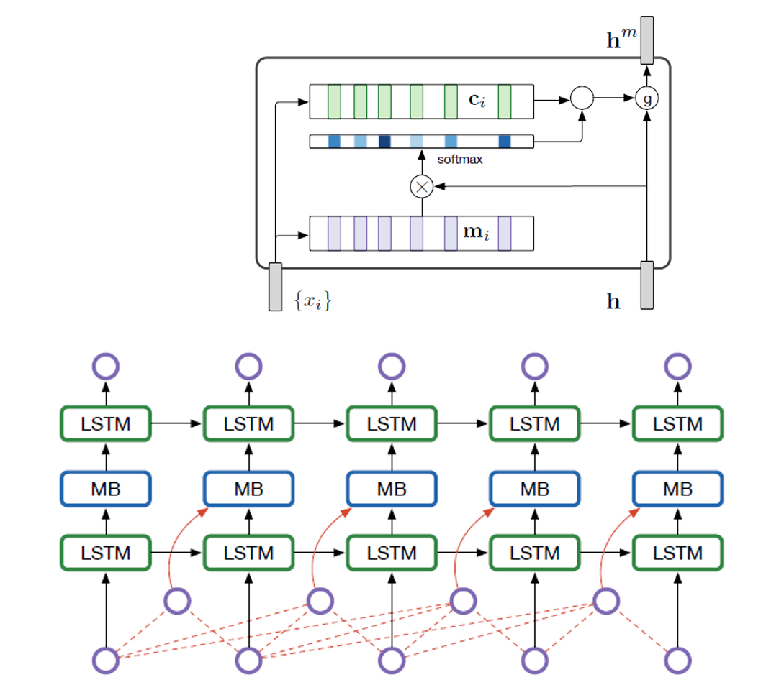
NAACL16-Ke Tran-Recurrent Memory Networks for Language Modeling

Slide 12
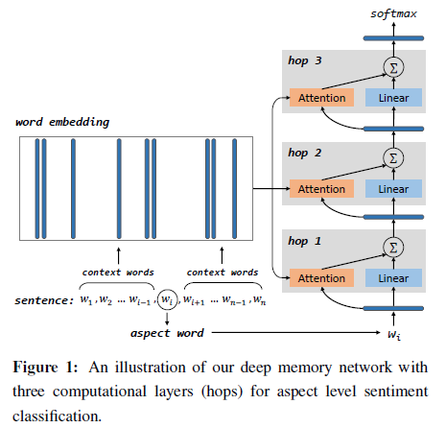
EMNLP16-HIT-Aspect Level Sentiment Classification with Deep Memory Network
Neural Machine Translation by Jointly Learning to Align and Translate

